Slide 1
Level 6 Group 5
Jay Pointer, Dalton Kirk and Ashley Burton

Slide 2
Log Line - A globally competitive snack game with tactical immersion
Demographic - 18-24 Males, Mobile Users
Focus on skill and mastery
Males tend to enjoy competition
Players Goal – Complete all the levels and achieve the highest score they can

Slide 3
Mechanics Ideas
Action | In Game Mechanics
Swipe | Fix Hole In Boat
Single Tap | Put Out Fires
Shake | Kill Sea Monsters
Multiple Tap | Repair Sail
Tilt | Feed Crew Members
Simultaneous Touches | Steer
 | Bucketing Water of Boat

Slide 4
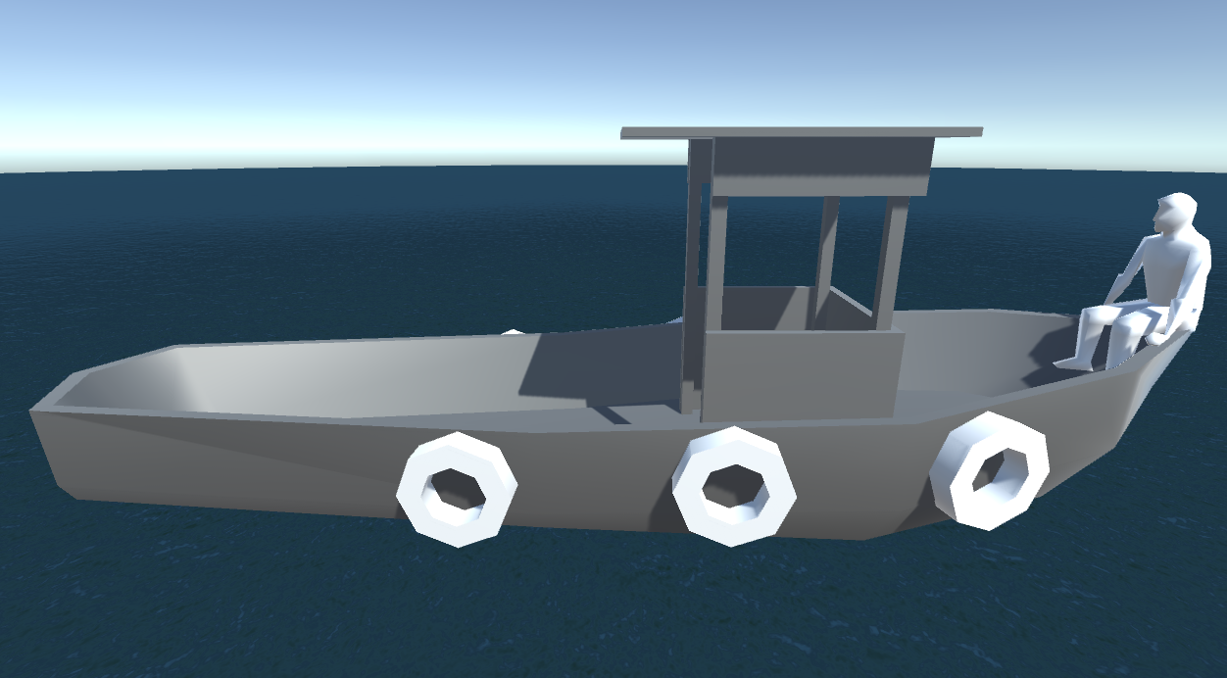
Player’s Initial Experience
Start game with 2 simple, easy mechanics
Learning the input controls and the games objectives
Player beings to practice mechanics
Mastery of current mechanics
Introduce new mechanic

Slide 5
Player Experience and Fun
Hard Fun
Links into Fiero
Player should feel accomplished when completing a level
Player Experience
Curiosity – Future mechanics
Stress – Failing to complete levels
Fiero – Completion of levels

Slide 6
Immersion
Tactical Immersion
In game where the skill required to complete a level brings a player into the game
Could be phrased as “In the Zone”

Slide 7
Tension and Release
Tension through each level
Increase overtime.
Keeping the player engaged.
Release once level is completed.
Release and Reward throughout the game
Rewards come with release.
Reward player with help on mechanics and score.
Repeating difficulty curve to keep the game interesting but accessible to players of all skill levels.
Learn, practice, master loop.
New mechanic
Hard
Tension
Time
Easy
Levels

Slide 8
Mobile Accessibility
UI
Size of everything on the screen
Art Style
Input
Short Levels (Snack Game 5-10 minutes play sessions)

Slide 9


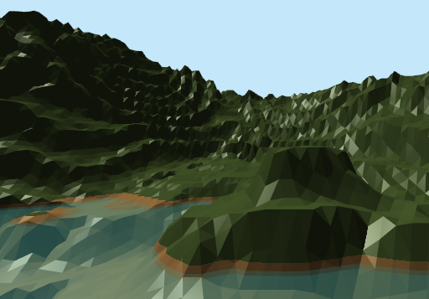
Art Style
Low poly 3d Art Style
Pastel Colours

Slide 10
Questions?

